Slide 1

The Global Game
An Analysis of Nationality in Professional European Football
Andrew Tremante
May 6, 2024

Slide 2

Introduction
How does nationality impact transfer strategies and player value in European football?
Motivation - The “English Tax”
Why is this important?
Significance to clubs, pundits, and fans

Slide 3
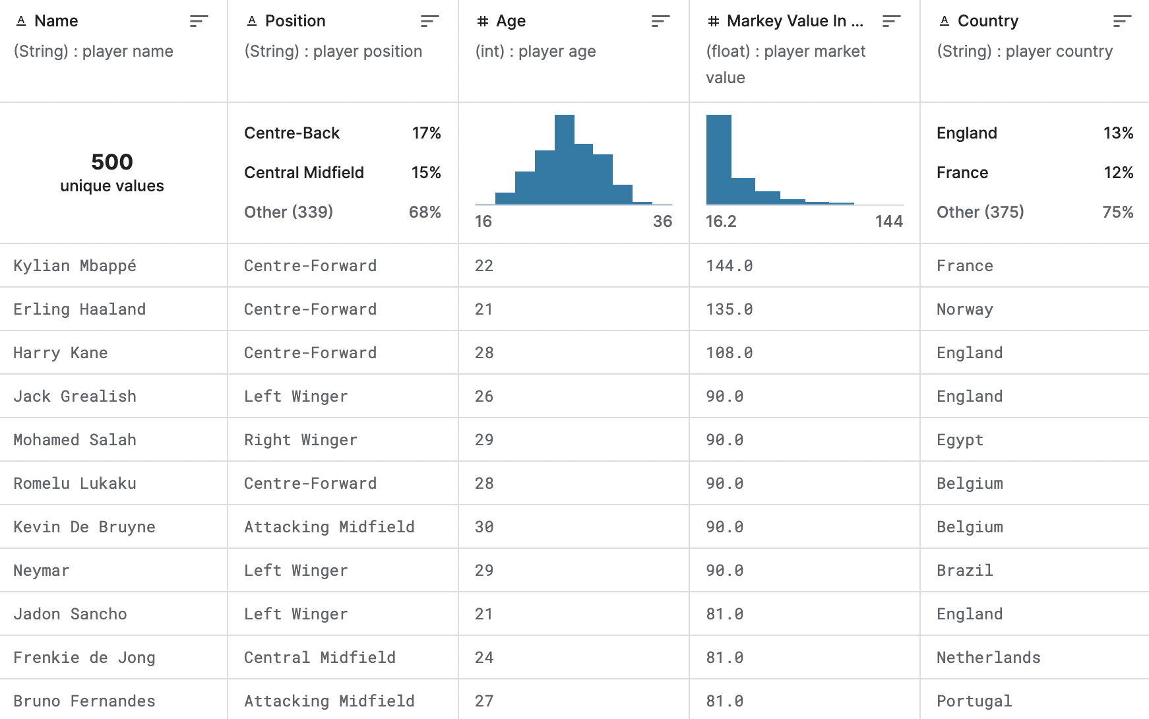
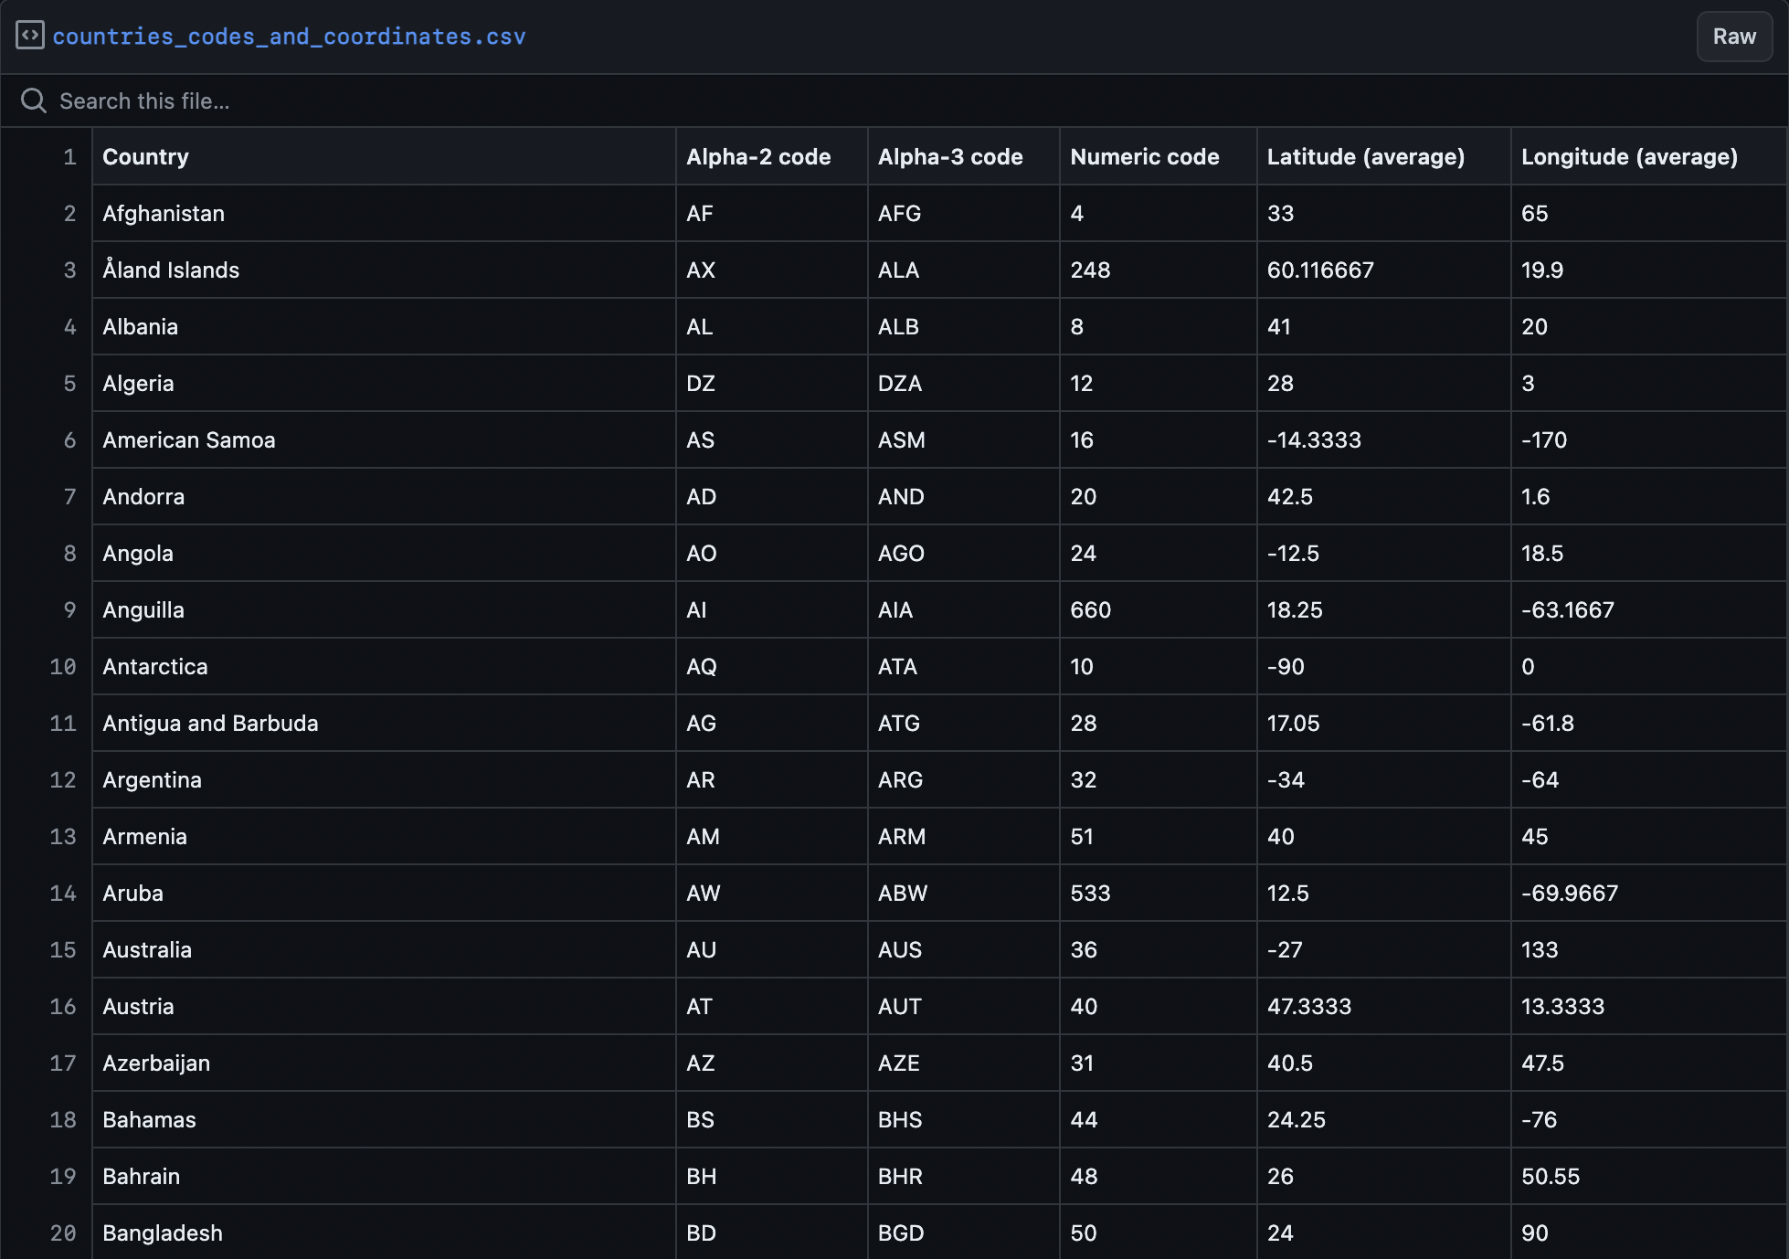
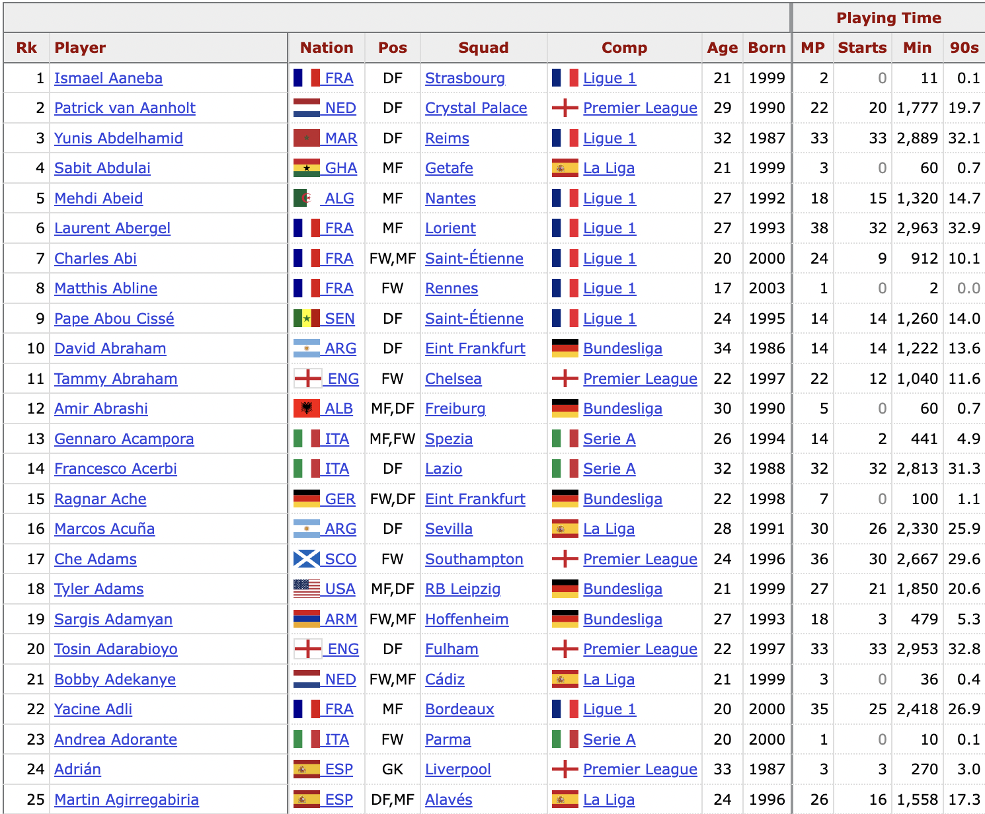
Data
Sources:
FBref - Performance
Kaggle - Financial
GitHub - Geographic

Slide 4
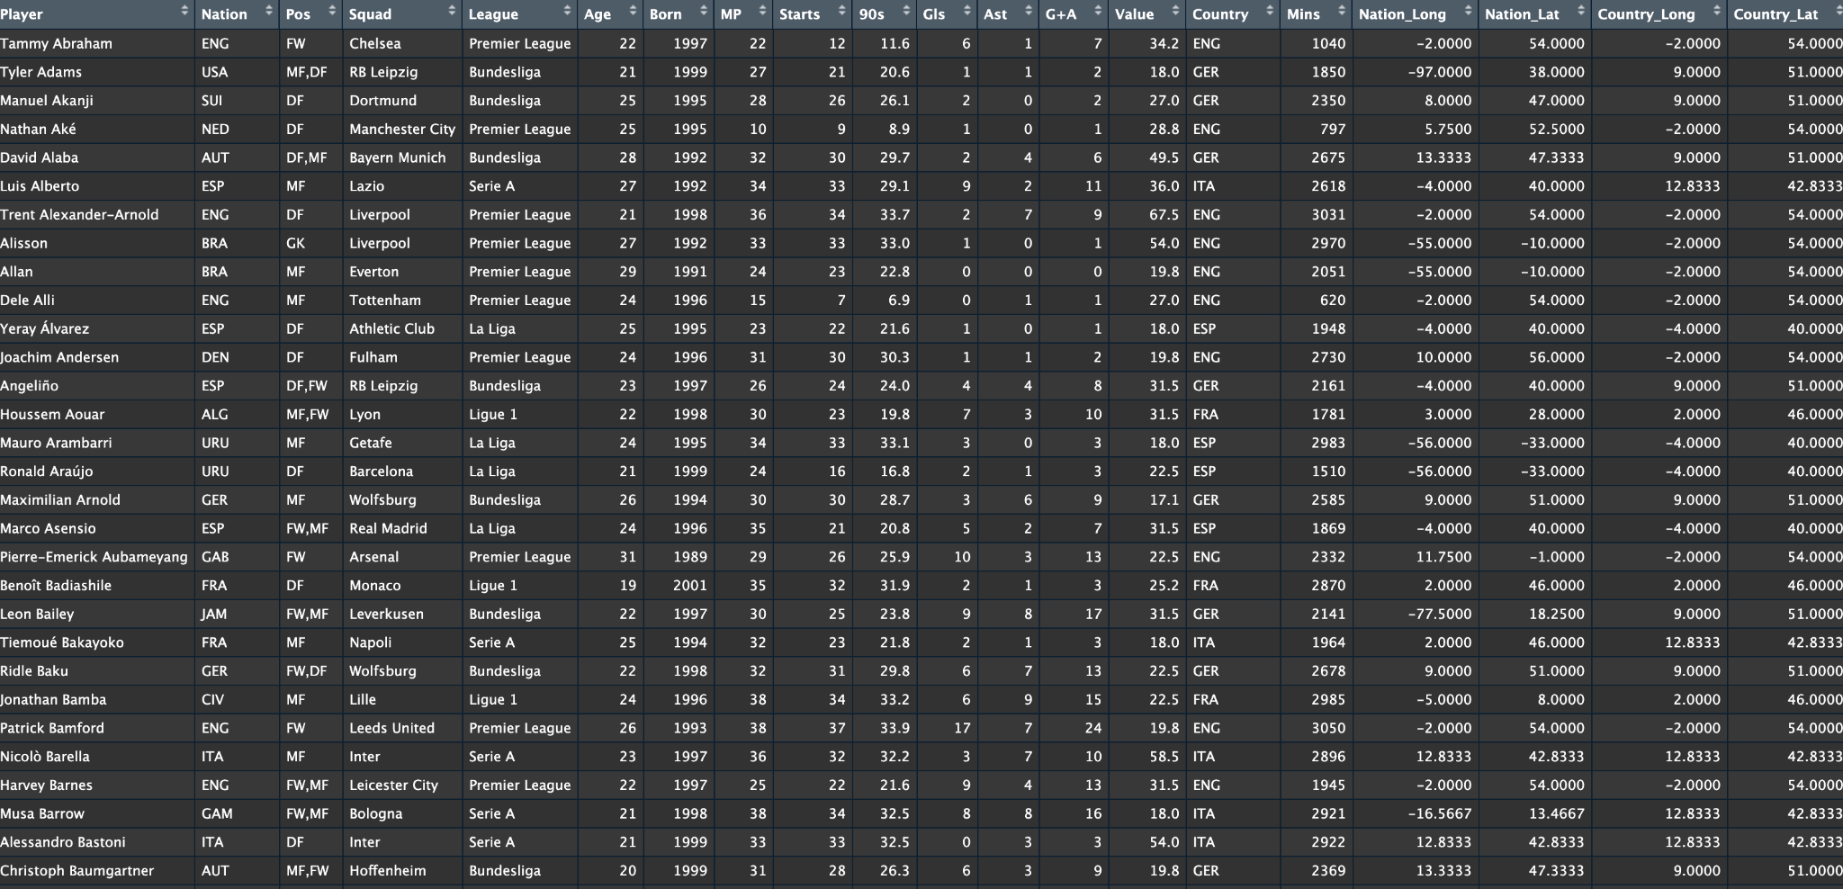
Final Dataset

Slide 5
Shiny App
Page 1 - Nationality
Page 2 - League
Page 3 - Clustering
Market value analysis by nationality
Filters for value, age, and minutes
What is the relationship between nationality and value?
League-specific player distributions
Mappings of player origins
Which nationalities dominate the most prominent leagues in Europe?
Hierarchical clustering by G+A, Value, and Age
What does clustering reveal about the most valuable players in the world?
Notes:
Page 1: Nationality
Market Value Analysis by Nationality: Enables exploration of how players’ market values vary by nationality, highlighting the economic impact of the "English Tax".
Age and Playing Time Considerations: Provides insights into the correlation between players' ages, minutes played, and their market valuations across different nationalities.
Interactive Data Engagement: Facilitates understanding of player statistics and demographics through interactive maps and dynamic filtering, allowing users to visualize the distribution of player characteristics geographically.
Page 2: League - Enhanced Spatial Data
League-specific Player Distributions: Illustrates the geographical diversity and origins of players within selected European football leagues, emphasizing the global nature of player recruitment.
Visual Mapping of Player Origins: Depicts connections between players’ countries of origin and their leagues, showing how leagues attract talent from specific regions.
Analyzing Recruitment Strategies: Allows users to examine how different leagues prioritize or favor certain nationalities, providing insights into recruitment strategies and league diversity.
Page 3: Clustering - Enhanced Unsupervised Learning
Pattern Recognition in Player Data: Uses hierarchical clustering to reveal patterns in players’ market values, performance metrics, and ages, highlighting underlying trends that may not be apparent from raw data alone.
Strategic Insights from Clustering: Offers strategic insights into player valuation, helping to identify clusters of players who may be undervalued or overvalued based on traditional metrics.
Dynamic Data Interaction: Engages users by allowing them to interact with clustering results, facilitating deeper insights into how various factors like performance and market demands influence player clustering.

Slide 6
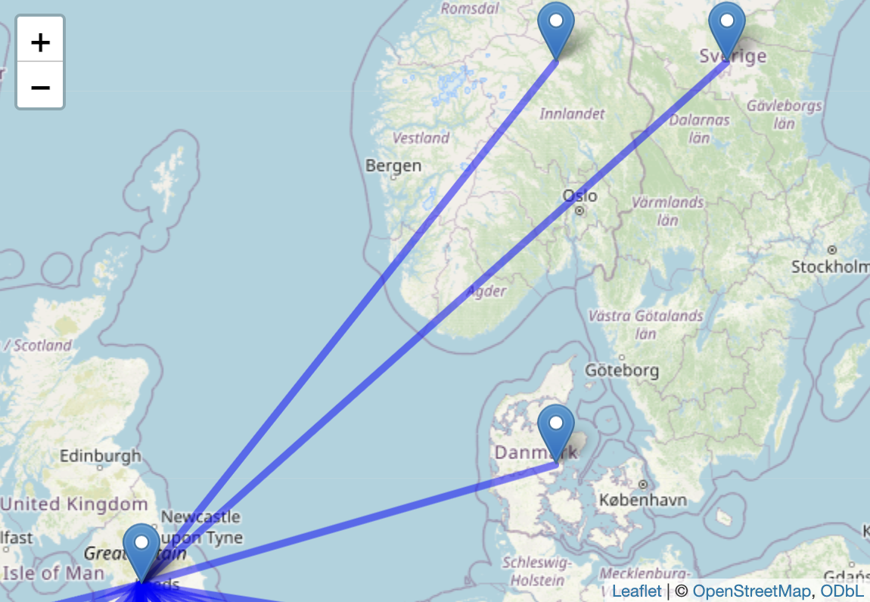
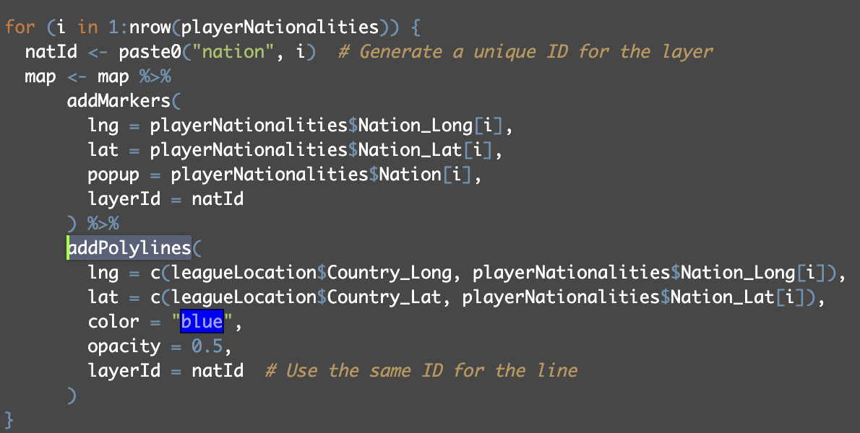
Going Beyond - Polylines
Polylines: one or more connected line segments, utilized in mapping to represent routes or connections between geographic locations
Notes:
Definition of Polylines: Polylines are continuous lines made up of one or more line segments, utilized in mapping to represent routes or connections between geographic locations.
Application in the Project: In the Shiny app, polylines visually connect players' countries of origin to the leagues they play in, illustrating the flow of football talent across Europe.
Visualizing Player Movement: Polylines help highlight patterns of player migration between nations and leagues, showing where talent originates and where it is most concentrated.
Enhanced Geographic Insights: By mapping these connections, polylines provide a clearer understanding of recruitment strategies and the geographic spread of players in European football.
Interactive Exploration: Users can interact with the map, clicking on polylines to reveal detailed data about the players connected by these lines, enhancing the interactive experience and providing deeper insights.

Slide 7
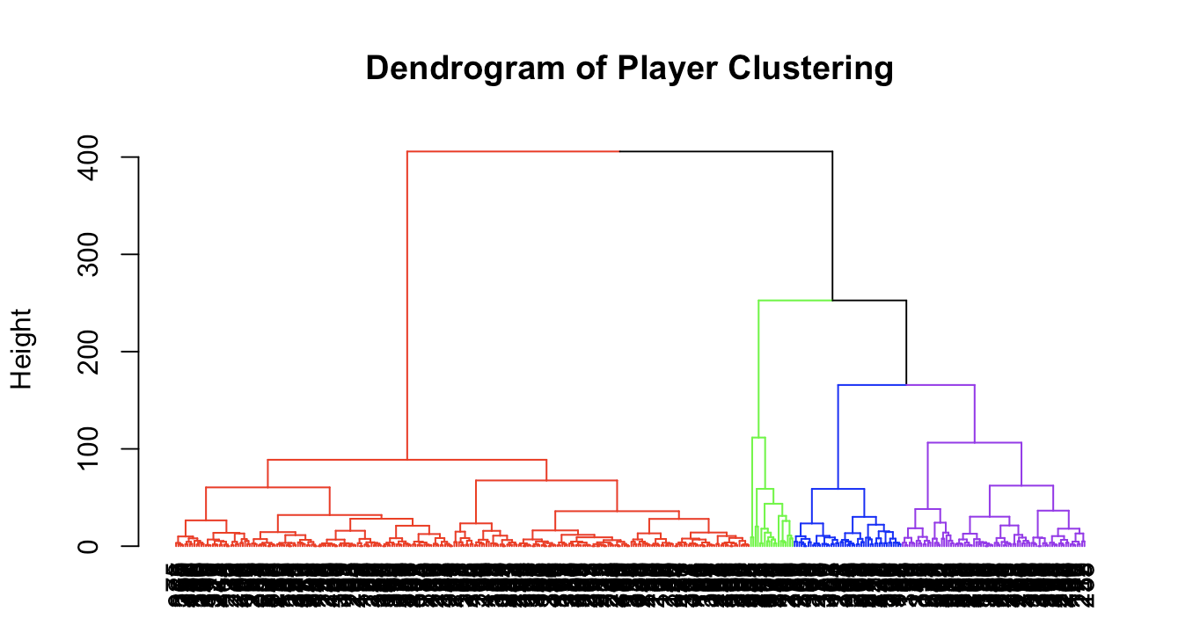
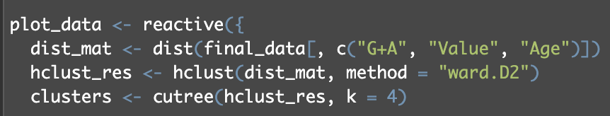
Going Beyond - Hierarchical Clustering
Hierarchical Clustering
Ward.D2
Value, G+A, Age
Dendrogram
Notes:
Purpose of Hierarchical Clustering: A method used to identify inherent groupings within player data based on similarities in market values, performance metrics, and demographics.
How Hierarchical Clustering Works: The method starts with each player as its own cluster and successively merges the closest pairs based on similarity, creating a tree-like structure (dendrogram) that represents the hierarchical relationships among players.
Ward.D2 Method: Implements the Ward.D2 method, which minimizes within-cluster variance, ensuring that the resulting clusters are compact and meaningful.
Analyzing Player Segments: Clusters reveal distinct groups of players, such as high-value talents, emerging stars, or underrated players, providing insights into market valuation strategies.
Strategic Insights for Clubs: Helps clubs understand player valuation patterns and identify potential undervalued or overvalued players, informing recruitment and negotiation strategies.
Visualization of Clusters: Results are displayed using dynamic scatter plots in the Shiny app, allowing interactive exploration of how players are grouped based on various attributes.
Enhanced Decision-Making: Provides data-driven insights that can influence decisions regarding player investments, scouting priorities, and overall team composition.

Slide 8
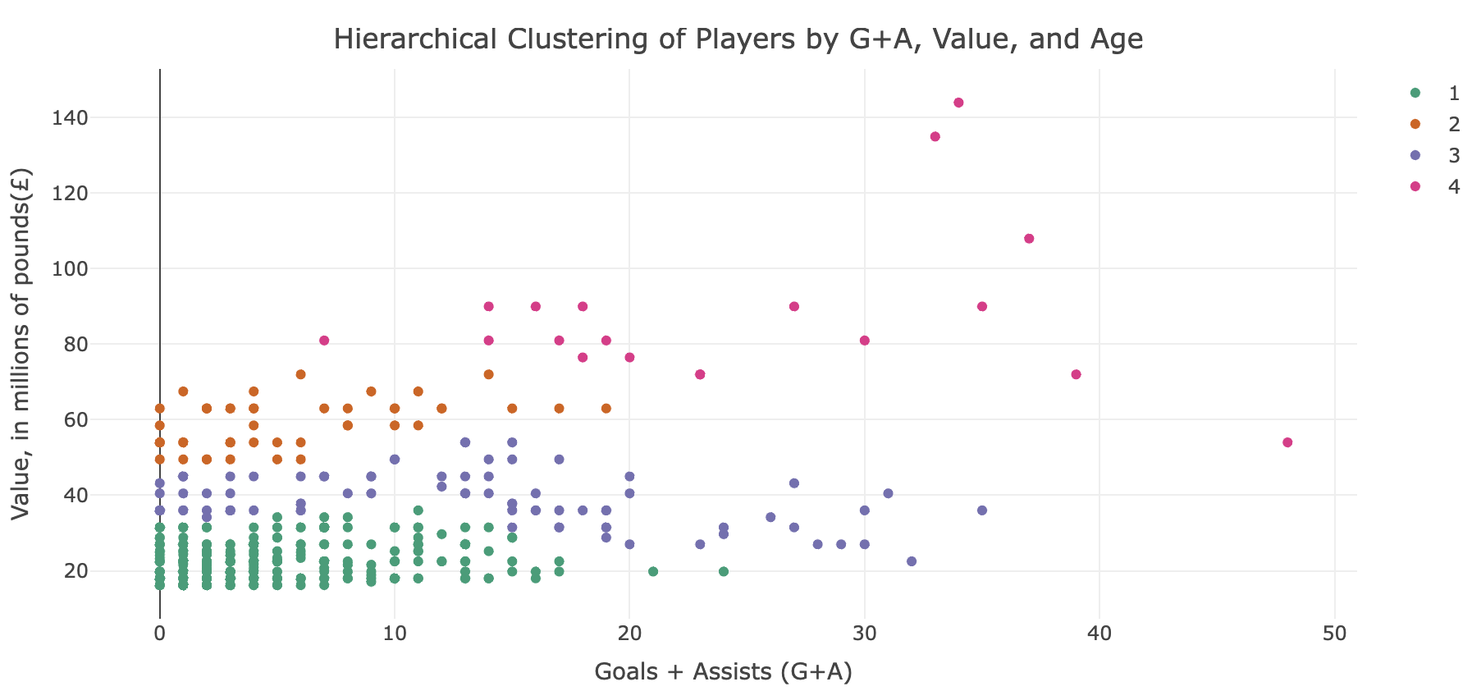
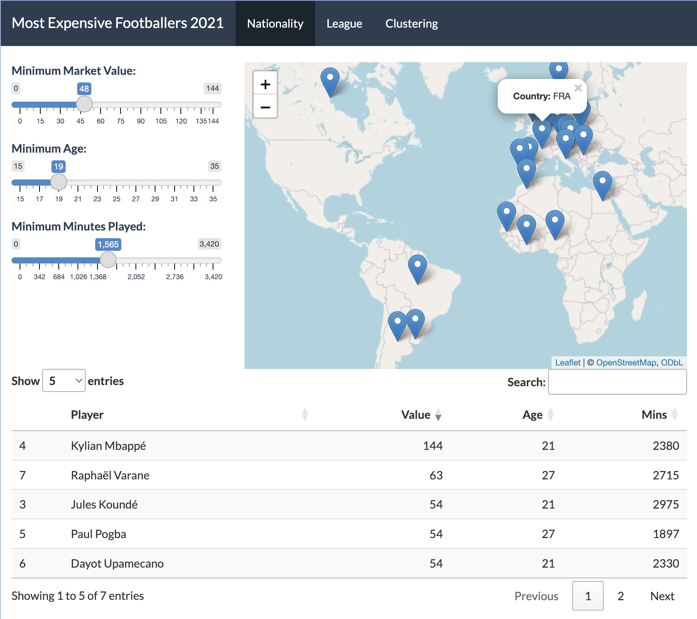
Findings
Nationality
Europe - Highest Value
South America - Youth
League
Germany + France - Foreign
England + Spain - Domestic
Italy - Foreign + Domestic
Clustering
Cluster 1 (Green): Lower value, younger
Cluster 2 (Orange): Diverse
Cluster 3 (Blue): High Potential
Cluster 4 (Pink): High Value

Slide 9


Conclusions
Significance of Nationality
Implications for Clubs and Leagues
Future Research
Limitations
Thank you! Questions?
Notes:
Confirmation of the "English Tax": The study confirms the existence of the "English Tax," where English players are valued higher in the Premier League, impacting transfer strategies and player valuation across Europe.
Significance of Nationality: Nationality plays a critical role in shaping player market values, with significant disparities observed between domestic and international players within the same leagues.
Implications for Clubs and Leagues:
Football clubs need to consider the premium placed on domestic players in their strategic planning and financial forecasting.
Leagues may need to review policies that potentially inflate the market value of domestic players to ensure competitive balance and financial sustainability.
Recommendations for Future Research:
Expand the dataset to include more leagues and lower divisions to understand if similar patterns exist beyond Europe's top leagues.
Utilize longitudinal data to track changes over time, potentially offering insights into how these trends evolve with changes in league policies and economic conditions.
Potential for Policy Adjustments:
Football governing bodies could use this analysis to consider adjustments in policies that might mitigate the excessive premiums on domestic players.
Enhancements in scouting and player development strategies could help balance the recruitment and valuation discrepancies.
Enhanced Analytical Tools: The use of advanced statistical models and data visualization tools, such as the Shiny app in this project, demonstrates the power of data science in analyzing complex issues in sports economics.

